Slide 1

WAD 2 PRESENTATION
SUSTAINABLEATS
G6T8
CHERYL | JUN WEI | BRENDAN | WILLIAM
https://youtu.be/-8ciSRxvlqI

Slide 2
Agenda
01
02
03
04
Our Solution
Problem Statement
Tools Used
Demo

Slide 3
01
Problem Statement

Slide 4
2 bowls of rice per day per person
744,000,000 KG
51,000 double decker buses (Weight)
Singapore: Food waste generated in 2019

Slide 5

Problem: Food Waste
Singapore Green Plan 2030 Goal
20% Reduction in waste-to-landfill per capita per day
Within five years or by 2026

Slide 6
02
Our Solution

Slide 7
—SustainablEats
Encourage sustainable food choices and reduce wastage by:
Empowering individuals and
Building a positive community

Slide 8

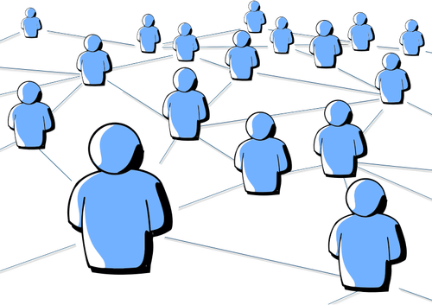
Recipe Generator
Social Platform
Recipes generated account for user’s taste and preferences based on their input of ingredients
Allow users to view, like and comment on recipes posted.

Slide 9


Profile Customization
Bookmark
Allow users to view, update, delete and create their own profile
Users are able to bookmark their favourite recipe

Slide 10
03
Tools Used

Slide 11





Tools
Firebase
Chatgpt AI
Bootstrap
Vue.js

Slide 12
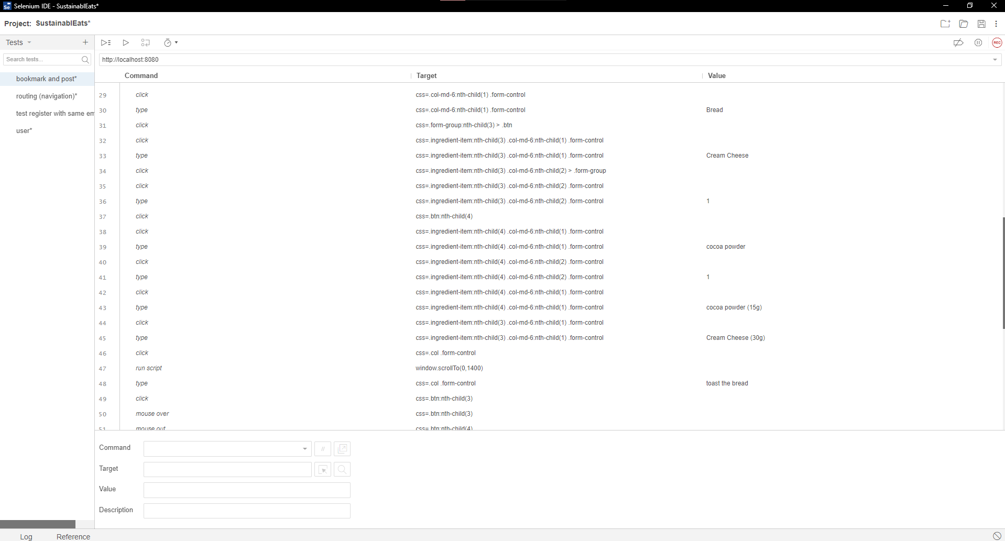
Helped us in testing some of our basic functions.
Especially when we had to move projects in firebase

Slide 13
04
Demo

Slide 14
Thanks!
Do you have any questions?

